Slide 1
Granite Stake Ham Radio License Training
Technician Class
January / February 2022

Slide 2
Resources for study
https://hamstudy.org EVERYONE should register here and use it for study / practice tests.
https://www.youtube.com/watch?v=0mP-Qe2SYwI&list=PLuapIzKwhZN_30dcgsDbGU3J7C8BAYJcG Dave Casler’s Technician Class License Series.
http://www.arrl.org/shop/Ham-Radio-License-Manual/ ARRL Ham Radio License Manual 4th Edition.
https://ARRL.org National Association for Amateur Radio.
W5YI Group – one of the earlier getting licensed organizations, some materials free others paid. https://w5yi.org
FCC Rules and Regulations Part 97: https://www.ecfr.gov/current/title-47/chapter-I/subchapter-D/part-97

Slide 3
Basic test notes
Entire Question Pool published online
Current Pool Expires after June of this Year
Pool divided into ten sections T1-T0
Each section divided into a variable number of sub sections, 35 sub sections in total.
Sub sections have a variable number of questions.
All questions are multiple choice.
Each test will have one question from each sub section.
No penalty for guessing.
Question Pool size: 423
  35 questions on test
  Must pass 26 questions

Slide 4
Technician Class Example Question:
T3A05 (B) When using a directional antenna, how might your station be able to access a distant repeater if buildings or obstructions are blocking the direct line of sight path?
Change from vertical to horizontal polarization
Try to find a path that reflects signals to the repeater
Try the long path
Increase the antenna SWR
http://ncvec.org/
Notes:
Note the (B) indicates which answer is right, that part will be left off of the final exam.
There will be several distractors away from the correct answer on most questions. In this case, I consider A & C to be distractors, and D to be completely wrong.
A. is wrong because in ham radio we use vertical polarization for repeaters, changing to horizontal polarization will significantly reduce the signal strength, which will just make things worse.
C. is wrong because the long path refers to pointing your antenna in the opposite direction and going all the way around the earth. This can work with HF Skip Communications, it does not work on VHF frequencies and above. 99% of repeaters are use VHF or higher frequencies.
D. Is completely wrong because the antenna SWR measure how much of the signal is reflected back to the transmitter by impedance mismatches. The higher the SWR the more the transmitted signal energy is turned into heat rather than being radiated by the antenna. If the SWR is high enough most modern radios will actually turn down their amplifier power levels to prevent damaging the TX.

Slide 5
Section T1
Rules and regulations

Slide 6
Section T1-A
Purpose and Regulating Entities

Slide 7
Purpose of Amateur (Ham Radio)
FCC Rules and Regulations Part 97.1 Basis and Purpose:
Recognition and enhancement of the value of the amateur service to the public as a voluntary
noncommercial communication service, particularly with respect to providing emergency communications.
Continuation and extension of the amateur's proven ability to contribute to the advancement of
the radio art.
Encouragement and improvement of the amateur service through rules which provide for
advancing skills in both the communication and technical phases of the art.
Expansion of the existing reservoir within the amateur radio service of trained operators, technicians, and electronics experts.
Continuation and extension of the amateur's unique ability to enhance international goodwill.

Slide 8
Regulating Bodies
International Telecommunication Union (ITU)
  United Nations Agency that establishes international treaties and standards regarding communications technologies. Established as International Telegraph Union on 17 May 1865 making it the oldest existent international organization.
  Splits world into three regions for managing radio spectrum:
    Region 1: Europe, Africa, The Former Soviet Union, Mongolia, The Middle East west of the Persian Gulf, western boundary is defined by line B
    Region 2: Americas, Greenland and some Pacific Islands. Eastern Boundary is defined by line B
    Region 3: Most of non Former Soviet Union Asia (FSU) including Iran and most of Oceana.

Slide 9
US Regulations
Federal Communication Commission (FCC)
  Established by Congress 19 June 1934 to regulate communications technologies in the US. Currently regulates:
    Radio
    Television
    Wire
    Satellite
    Cable

Slide 10
State / Regional
Frequency Coordinators
  In the Utah VHF Society http://utahvhfs.org
  Coordinators are agreed upon by the Amateur Radio operators who have eligible stations.
  Their purpose is recommending transmit / receive channels and parameters for auxiliary and repeater stations.

Slide 11
Non Governing Organizations
ARRL – Amateur Radio Relay League
  Largest Amateur Radio Society / Club in US.
  Most of the current rules were advocated for by the ARRL.
  Advocates for Amateur Radio Interests with ITU, FCC, and Congress.
  Publishes information about Amateur Radio.
  I encourage everyone to join if they become licensed.
  http://www.arrl.org
RACES – Radio Amateur Civil Emergency Service
  Allows local governments to use Amateur radio in times of disaster if their own equipment falls over.
  Managed by the individual states with licensed Amateur Radio operators.
  https://dem.utah.gov/resources-for-ems/radio-ares-and-races/
ARES – Amateur Radio Emergency Services
  Not codified in part 97 rules.
  Created by ARRL
  In Utah tends to work on the county level. I.E. Salt Lake County ARES http://www.slcoares.net

Slide 12
Local Organizations
Utah Amateur Radio Club (UARC)
  Founded 1927
  Open to everyone in Utah interested in Amateur Radio.
  https://user.xmission.com/~uarc/
Salt Lake Crossroads Amateur Radio Club
  Affiliated with SLC EMS
  https://Slcarc.org
  Works with safe neighborhoods program
Salt Lake County ARES
  Focused on providing public service communications in the Salt Lake County Area
  https://www.slcoares.net
Utah County ARES
  Focused on providing public service communications in the Utah County Area
  https://www.ucares.org
UtahSAG
  Focuses on providing communication at public service events
  Works with other clubs particularly the ARES clubs.
  Conducts licensing sessions
  https://utahsag.org
West Valley Amateur Radio Club
  Focused on West Valley City
  https://www.wvarc.org
Utah DX Association
  Focused on long distance communications and contests
  https://www.udxa.org
Many more…

Slide 13
Stations
Regular station, portable, car, boat, plane, house…
  No automatic control
Auxiliary station
  Privileges follow control operator privileges.
  1.25 Meter Band or higher for operation of Auxiliary controls.
  One way transmissions
  Can be automatically controlled
Beacon
  No more than one channel at a time TX
  Power of beacon no more than 100 Watts
  Can be automatically controlled
  Can transmit one way communications
Repeater Station
  Can retransmit on the 10 Meter or shorter bands
  Can be automatically controlled
Space Station
Earth Station
Space Telecommand Station
  Designated by licensee of the space station
  Can use codes that obscure the meaning of telecommand messages to station in space operation.
  Can transmit one way communications.
Telecommand of an amateur station
  Remote controls at station must be sufficient for the control operator to perform all of their duties.
  Control link malfunction will turn off transmitter within three minutes.
  License photo copy posted at station.
Telecommand of model craft
  ID is on label attached to transmitter
  Transmitter power must not exceed 1 Watt.

Slide 14
Stations
Regular station, portable, car, boat, plane, house…
Auxiliary station
Beacon
  For the purpose of studying propagation and similar experiements
Repeater Station
  Repeats signals.
Space Station
  Located 50 km above earth’s surface
Earth Station
  Below 50 km above earth’s surface.
Space Telecommand Station
  Controls a space station from ground
Telecommand of an amateur station
Telecommand of model craft

Slide 15
Types of station license grants
Operator / Primary station
  Most Amateur radio stations
Club station
  One person called a trustee designated by club an officer of the club
  Club must have at least four persons (only trustee must be licensed)
  Must have a Name
  Management
  Document of Organization
  Primary Purpose devoted to amateur service activities consistent with part 97 of FCC rules.
Military recreation station
  Held by license custodian designated by the official in charge of the US military recreational premises where the station is located.
    No required to be a licensed Amateur Radio Operator
    Cannot be a representative of a foreign government.

Slide 16
T1B
Radio Frequency Allocations

Slide 17
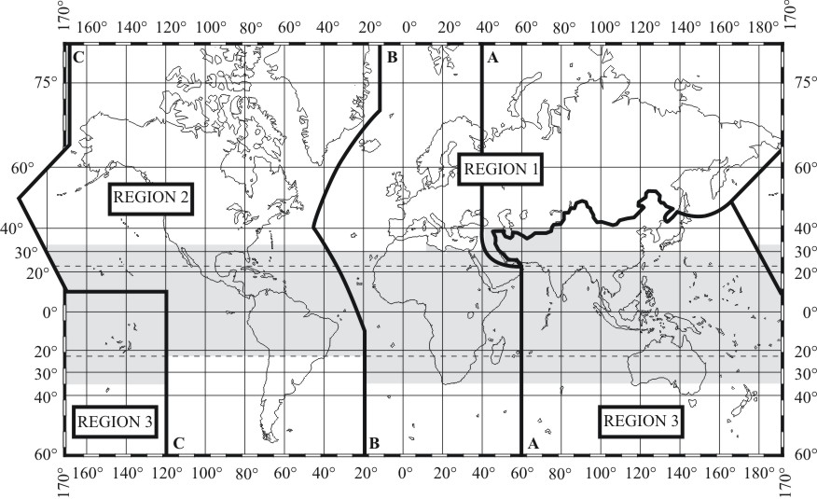
ITU Region Map
Notes:
Each ITU region has slightly different frequency ranges.

Slide 18
Frequency Usage
In the US we tend to use the ARRL published band plan https://www.arrl.org/band-plan & local frequency coordinator plans http://utahvhfs.org/bandplan1.html .
No one owns a frequency, but more rigid systems have been allocated a spot hoped to be non interfering.
It is never permissible to intentionally interfere with another station.

Slide 19
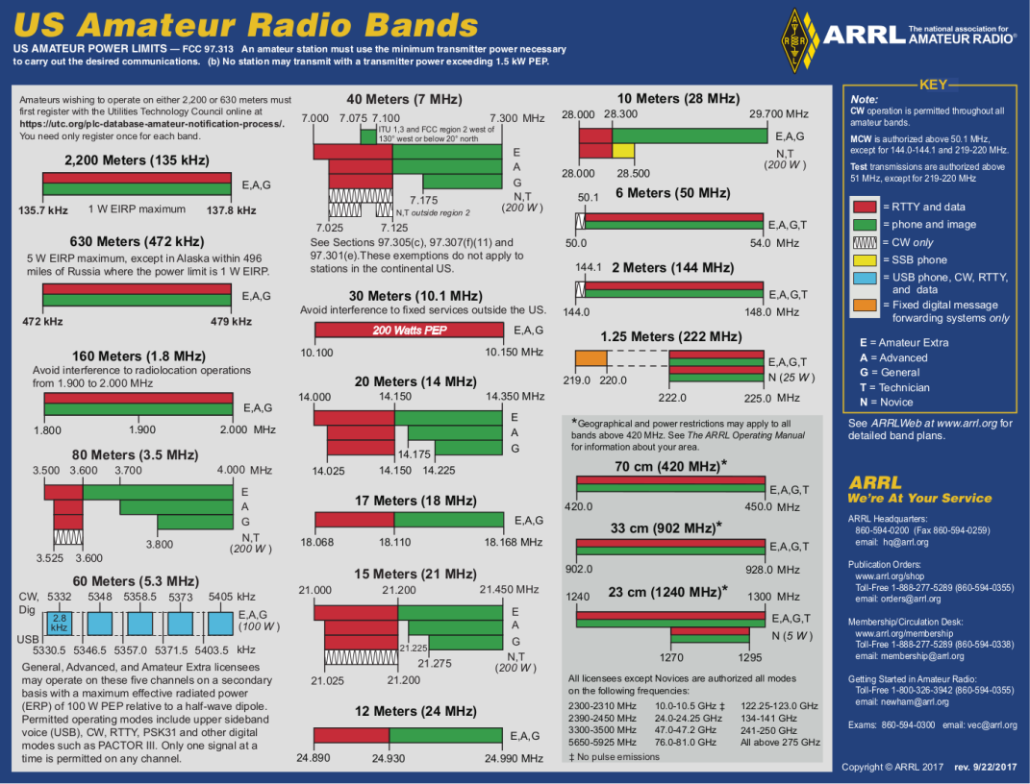

Slide 20
Emissions – The Basics
Unless specified otherwise max output 1500 Watts if you can do it safely
All signals are wider than their center frequencies, width is determined by how much information is embedded in the signal.
License class constrains which frequencies can be used.
Technicians can use all frequencies above 50 MHz, which is the six meter band or shorter (VHF, UHF, SHF, Microwaves).

Slide 21
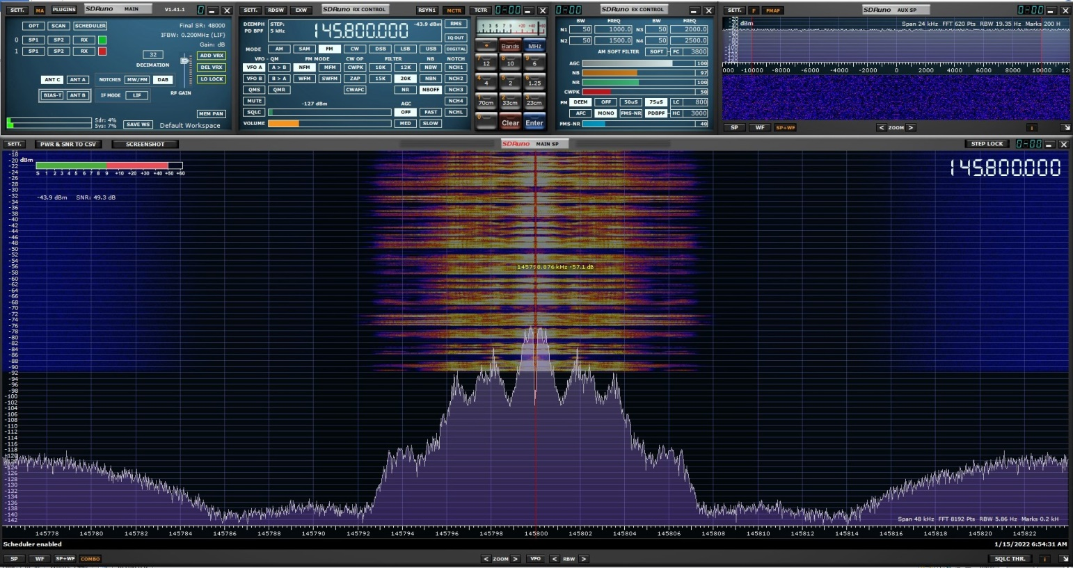
Picture of a FM transmission
Notes:
This photo shows the frequencies used by a Narrow FM signal at 145.80 MHz. The center frequency is the red line down the middle of the waterfall / Frequency display. This is a combination display, but if you look at the spectragraph chart at the bottom you will see that the signal occupies roughly from 145.793 MHz to 145.807 MHz. Thus signals have width….

Slide 22
T1C
Types of Amateur Radio Licenses in the US

Slide 23
License Classes
Novice* 200 Watt Power limit
Technician - 200 Watt Power Limit on HF
Technician Plus
General – 1500 Watt Power Limit
Advanced*
Extra – 1500 Watt Power Limit
*no longer licensed but can renew

Slide 24
Call Sign Patterns
2x3 – Novices
  KD7NLF, WE7LUV,
1x3 – Technician & General class.
  W7HPW, K6BDE, K7BYU, K7UTE
2x2 – Advanced class
  AF7SJ, KK7JO
1x2 and 2x1 – Extra class
  A7SJ, N5OM
US Call signs start with A, N, K, or W
Numbers are based on initial licensed region.
The vanity license program allows any licensed amateur to request unassigned calls from any pool.

Slide 25
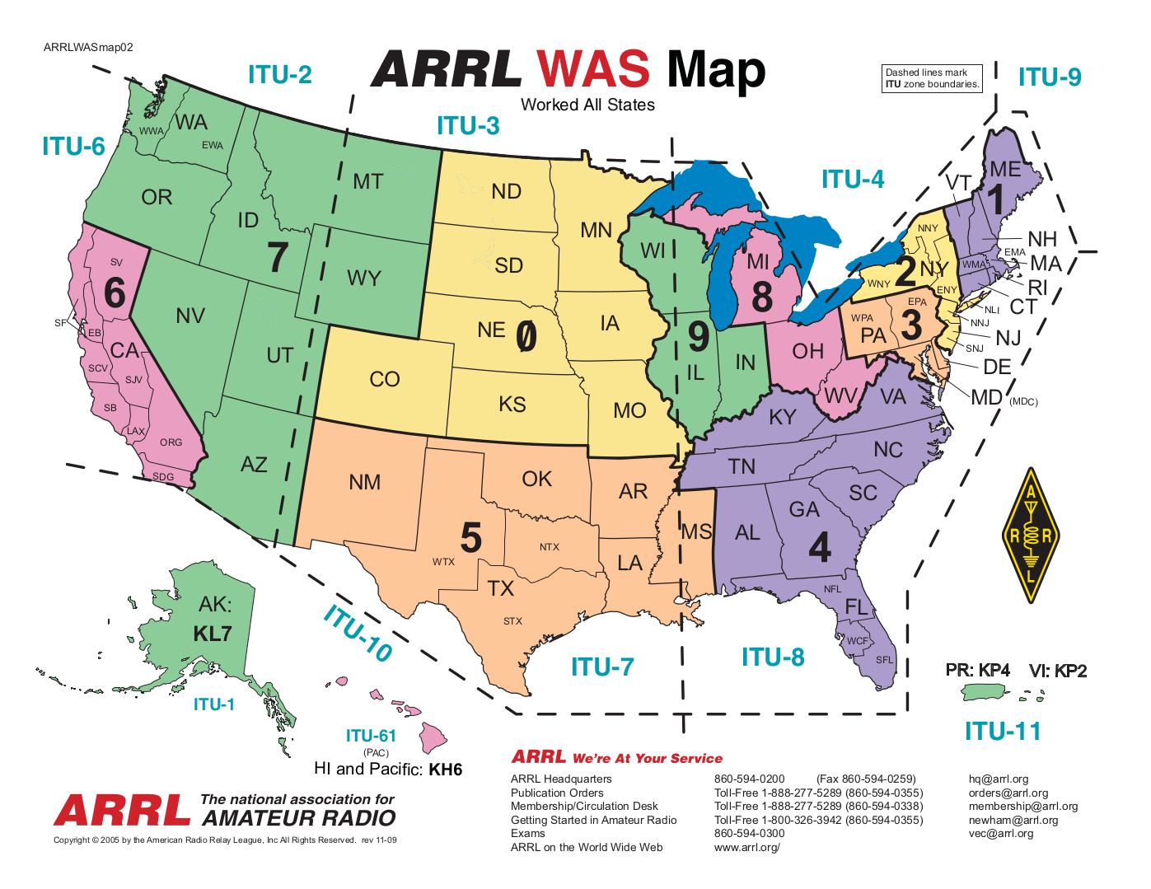

Slide 26
Regulatory Requirements
Must maintain valid mail contact information with the FCC
Licensed for ten years
There is a two year grace period during which you can renew without retaking the test.
While expired you cannot operate until renewal is published in FCC database.
Validity is always based on FCC ULS Database: https://wireless2.fcc.gov/UlsApp/UlsSearch/searchAmateur.jsp

Slide 27
Operating Area
Anywhere in US jurisdiction except for radio silence locations.
On any US flagged craft.
Any country that permits it (Canada yes, Mexico no).

Slide 28
T1D
Regulations regarding transmitting

Slide 29
Transmission Rules
Permitted one way transmissions:
  Morse code practice
  Information bulletins
  Transmissions to provide emergency communications
  Telemetry
  Beacons
  Brief station setup and tests.
No music on voice emissions except when authorized to and retransmitting manned spacecraft communication.
You can on occasion sell or trade your amateur radio equipment over the air as long is it isn’t a regular occurrence.
No indecent or obscene language
Can speak with no country that has notified the ITU that it doesn’t want US Amateurs to communicate with its citizens.
Only with signals to control space stations or radio controlled craft can the message be encoded to hide the meaning.
You can be paid to operate a ham radio if you are a educator at a education institution if it is incidental to class room instruction.

Slide 30
Additional Rules
Broadcasting are messages designed to reach the general public, we are forbidden from broadcasting.
If immediate safety of human life or protection of property comes up the rules don’t matter until the situation is resolved.
Signals to control model craft do not need to be identified over the air, but the transmitter needs to have the station call sign clearly affixed to it.
Control of model craft is limited to a power output of one watt.
A station must always have a control operator. Even if operating in automatic mode.

Slide 31
Station rules
Two types of licenses:
  Station license
  Operator license
Operator license determines the privileges.
Station license holder determines who is allowed to operate.
Both are equally responsible for following the rules.

Slide 32
Station Rules
There must always be a control operator
Automatic control is permitted for:
  Auxiliary
  Repeaters
  Space Stations
  Beacons
You are only responsible for your input frequency, not the output frequency of any repeating station.
Remote control means you control the station and manipulate the controls from a remote control point.
The control point is wherever the station is controlled from.
Clubs of 4 or more individuals can apply for a club station license.

Slide 33
Identification rules
Must ID at the end of a communication and every ten minutes during the communication.
ID must be in English
CW (Morse Code) is always allowed for identification purposes, no matter the mode being used.
For speaking call sign you can use the phrases stroke, slant, slash to preface custom call modifiers.
  For example if I’m operating in California I might give my call sign as AF7SJ/W6. The W indicates the lower 48 states, and 6 is the call sign area. If I was operating in DE I could do AF7SJ/W3.

Slide 34
Repeaters
Retransmit signals automatically
Control operator of the originating station is responsible to the FCC for rules violations

Slide 35
International Operating Rules
A non licensed person is allowed to speak to a foreign station if the US has a third party agreement with that country.
No restrictions on third party communications in the US other than standard ham radio rules.

Slide 36
Section T2
Operating Practices

Slide 37
Transmissions
Most radio transmission is called simplex which means the station is either transmitting or receiving but not both at the same time.
Repeaters are duplex which means they transmit and receive at the same time.
  To transmit and receive at the same time means you need a separate transmit and receive frequency.

Slide 38
Simplex Frequencies
Some frequency ranges are identified in the regulations for simplex operation only.
146.52 MHz is the national simplex frequency on the 2 meter band.
Simplex frequencies allow communication without tying up repeater inputs.

Slide 39
Repeater Frequencies
TX frequency is the output frequency of the repeater (you will set your radio’s RX to the frequency).
RX frequency is the frequency the repeater listens on (you set your radio’s TX to that frequency).
  On the 2 meter band the RX frequency is either + or – 600 kHz from the TX frequency.
  On the 70 centimeter band the RX frequency is + or – 5 MHz from the TX frequency.
Some radios have a reverse split button that reverses their TX and RX frequencies. This can be used to work around poorly received stations if you are closer to the station than the repeater.

Slide 40
Transmissions
You must always identify if transmitting on the air, even when testing.
CQ means calling any station.
On a repeater just putting out your call sign indicates you are there and would love to talk to anyone.
Band plans are voluntary, but important.
Before starting a contact:
  Make sure you have the rights to talk on the frequency
  Listen to see if anyone is using the desired frequency
  Ask if anyone is using the frequency
  Call CQ or put out your call sign.
When responding to a CQ state the stations call sign followed by your call sign.
If two stations are trying to use the same frequency common courtesy should prevail. No one owns a frequency.

Slide 41
T2B
Operating practices applied.

Slide 42
Common Modes
SSB - (Single Side Band) used on most bands and every VHF / UHF band, equipment is kind of expensive. Very good for weak signal work. Transmitters tend to be bulky, but highly efficient.
CW - (Morse Code) used everywhere.
FM - VHF and above.
DMR - VHF and above.

Slide 43
Repeater Detail
Reverse split listens to the input frequency of the repeater. A weak station might be hearable this way.
CTCSS & DCS is used to only allow certain signals to be repeated.
You can overdrive the audio and it will break up in the repeater making it hard to understand you. If told this is happening talk farther from the microphone.

Slide 44
DMR
Digital voice modulation
Split into talk groups on the repeater. You only hear the groups your radio currently subscribes to.
You need to program these talk groups into the radio

Slide 45
IRLP
Links repeaters over the internet
Is controlled using DTMF (the old touch tone phone standard).
Allows repeaters to have a global audience.

Slide 46
Q Codes
Used as a quick way to express or query something.
  “QSY?” – Should we change frequency
  “QSY 146.52” – I’m changing to 146.52
  “QRM?” – are you having signal interference?
  “QRM” – I’m experiencing signal interference.

Slide 47
Emergency and Formal Messages
T2C

Slide 48
FCC RULES
FCC rules always apply…
Having said that, the rules state you can operate outside your frequency privileges if it involves immediate safety of human life or protection of property.

Slide 49
Nets Part 1
Formal sessions using specific frequencies
Net Control Station or NCS is the station running the net.
The net will start with a preamble to describe the purpose and protocols of the net.
If you need immediate attention to report a emergency begin your transmission with priority or emergency followed by your call sign.
Traffic refers to formal messages for the net.

Slide 50
Nets Part 2
Remain on the frequency for the duration of the Net.
Only transmit when directed.
You should pass any message exactly as it was received.
Check refers to the number of words in the body of the message.
Tactical call signs can be used. E.G. NCS, race 1, bike 2, corner 5, etc.
When using tactical calls signs you still must use your own call sign every ten minutes and at the end of the conversation.

Slide 51
ARES
Licensed amateurs who have voluntarily registered their qualifications and equipment for communications duty in the public service.

