Slide 1
Granite Stake Ham Radio License Training
Technician Class
January / February 2022
Class 2

Slide 2
Review Resources for study
https://hamstudy.org EVERYONE should register here and use it for study / practice tests.
https://www.youtube.com/watch?v=0mP-Qe2SYwI&list=PLuapIzKwhZN_30dcgsDbGU3J7C8BAYJcG Dave Casler’s Technician Class License Series.
http://www.arrl.org/shop/Ham-Radio-License-Manual/ ARRL Ham Radio License Manual 4th Edition.
https://ARRL.org National Association for Amateur Radio.
W5YI Group – one of the earlier getting licensed organizations, some materials free others paid. https://w5yi.org
FCC Rules and Regulations Part 97: https://www.ecfr.gov/current/title-47/chapter-I/subchapter-D/part-97

Slide 3
Remember Basic test notes
Entire Question Pool published online
Current Pool Expires after June of this Year
Pool divided into ten sections T1-T0
Each section divided into a variable number of sub sections, 35 sub sections in total.
Sub sections have a variable number of questions.
All questions are multiple choice.
Each test will have one question from each sub section.
No penalty for guessing.
Question Pool size: 423
  35 questions on test
  Must pass 26 questions

Slide 4
Technician Class Example Question:
T3A05 (B) When using a directional antenna, how might your station be able to access a distant repeater if buildings or obstructions are blocking the direct line of sight path?
Change from vertical to horizontal polarization
Try to find a path that reflects signals to the repeater
Try the long path
Increase the antenna SWR
http://ncvec.org/
Notes:
Note the (B) indicates which answer is right, that part will be left off of the final exam.
There will be several distractors away from the correct answer on most questions. In this case, I consider A & C to be distractors, and D to be completely wrong.
A. is wrong because in ham radio we use vertical polarization for repeaters, changing to horizontal polarization will significantly reduce the signal strength, which will just make things worse.
C. is wrong because the long path refers to pointing your antenna in the opposite direction and going all the way around the earth. This can work with HF Skip Communications, it does not work on VHF frequencies and above. 99% of repeaters are use VHF or higher frequencies.
D. Is completely wrong because the antenna SWR measure how much of the signal is reflected back to the transmitter by impedance mismatches. The higher the SWR the more the transmitted signal energy is turned into heat rather than being radiated by the antenna. If the SWR is high enough most modern radios will actually turn down their amplifier power levels to prevent damaging the TX.

Slide 5
T3 Radio Wave Theory
How radio waves work / propagate to communicate.

Slide 6
T3A - Propagation
How radio waves propagate

Slide 7
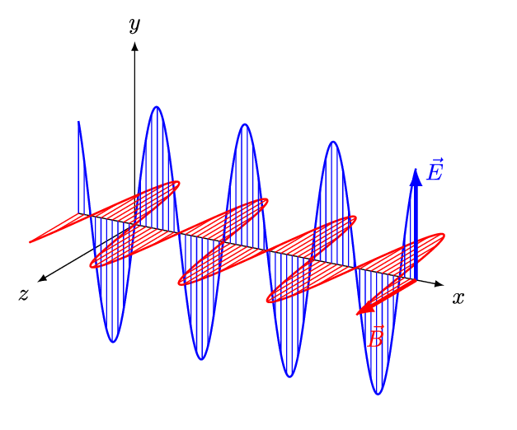
Radio waves = Electromagnetic waves
Electromagnetic wave, vertically polarized.
Corresponding magnetic wave is horizontally polarized.
All radio waves are EM waves.
Note: I believe the diagram is inverted, magnetic wave should go to the right when electrical wave goes up….
Image courtesy of And1mu use licensed by Creative Commons Attribution-Share Alike 4.0 International License

Slide 8
Radio Waves Bounce….
Off surfaces.
Off the ionosphere
Off of magnetic fields.
Even off of different temperature layers of the atmosphere.
Strength of reflection varies depending on the wavelength of the signal and density of material.
The shorter the wavelength the more likely it is to be reflected by a object in its path.
As the wavelength becomes shorter than pi * radius of a hole it will penetrate the hole.
This means objects 1/3 the size of the wavelength will significantly reflect the signal.
Even thermal differences in the atmosphere can reflect radio waves.

Slide 9
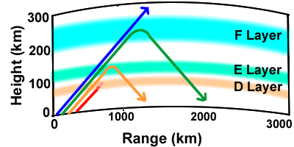
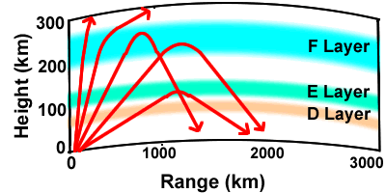
Ionosphere
The Ionosphere is the upper atmosphere around our planet.
Solar radiation strips off the electrons and turns it into a plasma which is reflective of radio waves below the Max Usable Frequency. This varies based on the current levels of Solar Radiation.
Frequencies below the current Max Usable Frequency (MUF) are reflected by the Ionosphere back to earth.
The higher the frequency the higher the reflection occurs, which means more distance is covered.
The angle that the signal travels from the ground to the atmosphere also affects how long the skip path is.
Medium Frequency waves are absorbed by the D layer.
The D layer dissipates after dark, which allows Medium frequency waves to utilize skip communications.
This creates daytime vs nighttime bands:
  40 Meters and below night time
  30 Meters and above daytime
By Naval Postgraduate School - http://www.weather.nps.navy.mil/~psguest/EMEO_online/module3/module_3_3.html, Public Domain, https://commons.wikimedia.org/w/index.php?curid=1779095

Slide 10
Multipath
Reflections off of the ionosphere, buildings, cars, uneven ground etc. can mean you receive multiple versions of the same signal (rays if you will) that have taken different paths to reach your receiver. These different paths will have different timings.
Because they take different paths they will arrive a slightly different times, which can make the signals cancel each other out in spots.
If you or the station you are hearing is in motion this can create a fluttering sound with the regular signal and static interspersed several times a second. This is called picket fencing.
Because the reflections are random, it often only takes moving a few inches to change which signals strike the antenna making a signal go from very week to clear and full strength.
When transferring digital data, multipath will increase the error rate.

Slide 11
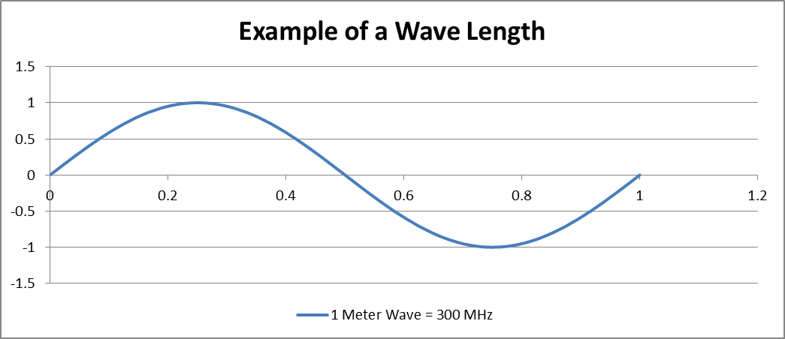
More Detail on RF / EM Waves
EM waves in free space go at the speed of light (e).
Speed of light is roughly 300 Million Meters Per Second
One Wave Length is the distance a wave travels across one cycle (see picture).
Formula is frequency in MHz divided by 300
e.g. 300 MHz / 300 = 1 Meter
We often use the approximate wavelength to refer to a frequency band such as:
2 Meter Band = 146 MHz
70 cm Band = 440 MHz

Slide 12
Attenuation
Attenuation means a reduction in power
If attenuation is severe enough the signal will become unintelligible.
Common causes of attenuation are:
  Conversion of the radio wave into heat as it’s absorbed into materials.
  Dispersion of the wave over distance.
  A portion of the signal being reflected into a non desired direction.
Is measured in dB or Decibels.
The shorter the wavelength the more easily it is absorbed and reflected.
Multipath signals can cancel each other out causing massive attenuation.
Mismatched polarization attenuates the received signal.

Slide 13
Common Environment Attenuators by Spectrum
Spectrum | Wavelength | Frequency Range | Attenuators
MF | 1000 – 100 m | 300-3000 kHz | Mountains
HF | 100 – 10 m | 3-30 MHz | Buildings
VHF | 10 – 1 m | 30-300 MHz | Trees, People
UHF | 1 – 0.1 m | 300-3000 MHz | Small Objects
SHF | 100 – 10 mm | 3-30 GHz | Precipitation
EFH | 10 – 1 mm | 30-300 GHz | Dust, Clouds, Gases
* Spectrum names and frequency ranges appear on the test (HF, VHF, UHF)

Slide 14
Polarization
We refer to the electrical portion of the EM wave as the orientation, so if the Electronic portion is going up and down it’s vertically polarized.
If it is going side to side it’s horizontally polarized.
The signal matches the antenna’s physical polarization, meaning a wire pointing vertically will emit a vertically polarized signal.
FM Voice and mobile radios are mostly vertically polarized.
SSB tends to be horizontally polarized.
If receiver polarization doesn’t match the transmitters it will be strongly attenuated.
If the signal is reflected off the ionosphere it will become elliptically polarized. Which means both horizontal and vertical antennas receive the signal equally badly.
Satellites will sometimes use circular polarization, either clockwise or counter clockwise.

Slide 15
Solar Cycle
The sun’s radiation interacts with the sparse gases at the edge of our atmosphere to ionize them, which makes them reflective to radio waves.
The more consistent radiation the more ionization occurs.
A solar flare can disrupt ionosphere based communication.
The sun has a 11 year cycle between peak and low solar output.
Currently the sun is increasing its solar power output, peak cycle is forecast as July 2025 (NOAA solar cycle 25 forecast update).
You can tell activity is increasing when sun spot counts increase.

Slide 16
Max Usable Frequency
The faster a radio wave cycles the less affected it is by the Ionosphere:
The maximum frequency that will be reflected by the Ionosphere and return to earth is called the Max Usable Frequency.
In the summer months the longer daylight will build the E layer enough to enable skip communication from 10 Meters through 2 Meters, called sporadic E communication.

Slide 17
Aurora Propagation
The Aurora (Northern Lights, Southern Lights) when it becomes very active can enable communication.
MUF can go into the VHF range.
At VHF the signals are weak and fluttery with rapid fading.

Slide 18
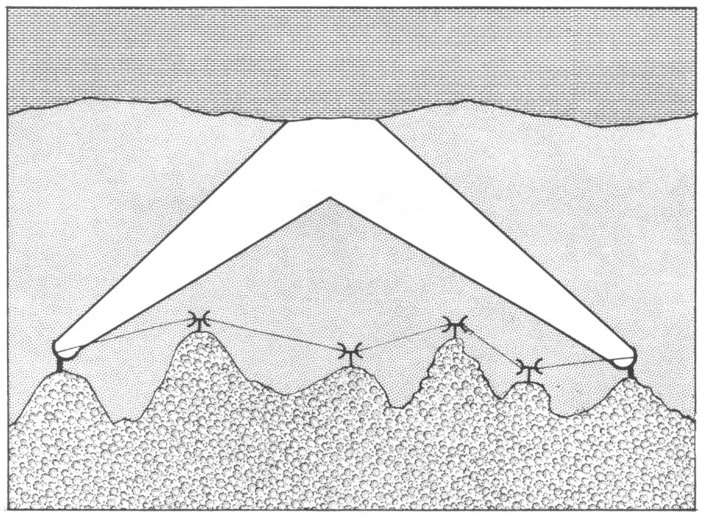
Tropospheric Scatter
The Troposphere is the lowest
layer of atmosphere.
A temperature inversion (cold air layer under
a hot air layer) will bend VHF & UHF radio
waves and direct them along the curvature of
the earth far beyond the horizon (hundreds of
miles).
I think of it as a mirage in the sky for radio
waves.
It is called Tropospheric Ducting
The Military used this for reliable long distance communication from 1950’s to the 1970’s when they switched to satellites. To make it reliable they used tens of kilowatts of power on the transmitters.
Notes:
To

Slide 19
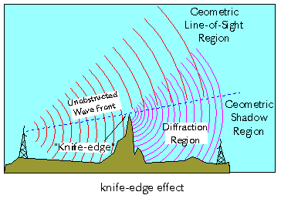
Knife Edge Refraction
Radio Wave crossing a hard boundary is regenerated (diffracted) by the edge and radiates into the shadowed area
Useful from VHF, UHF, and Microwave spectrum to communicate around corners and hard objects
Can contribute to multipath in the non shadow area.
A directional antenna can be used to better take advantage of this effect.
The shorter the wavelength the more likely this is to happen (smaller obstacles).
Image Courtesy ITS

Slide 20
The Radio horizon
The radio horizon is farther away than the optical horizon (barring mountains).
The longer the wavelength the less curved the earth appears.
On a flat sea, the radio horizon is about 4/3 of the optical horizon.

Slide 21
Spectrum Pluses & Minuses
Band | Bandwidth | Spectrum | Ionosphere | Sporadic E | Aurora reflection | Tropospheric Scatter | Meteor Scatter
80 M | 500 kHz | HF | Night |  | X
40 M | 300 kHz | HF | Night |  | X
20 M | 350 kHz | HF | Daytime |  | X
10 M | 1.7 MHz | HF | Daytime when peak solar cycle | Common | X
6 M | 4 MHz | VHF | Occasionally | X | X | Occasional | Best
2 M | 8 MHz | VHF |  | Less Common | Rapid Fluctuations | Some | X
1.25M | 4 MHz | VHF |  |  |  | Some | X
70 CM | 30 MHz | UHF |  |  |  | Best

Slide 22
T4 Station Equipment
What and how we use it

Slide 23
Station Parts
Basic Station Components and Accessories

Slide 24
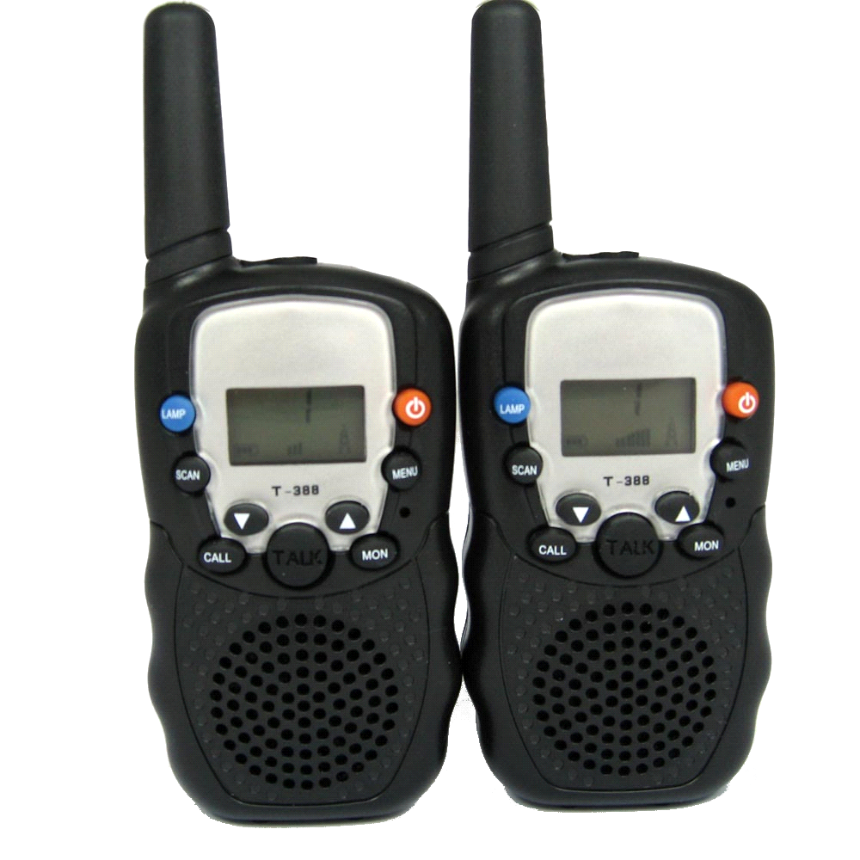
The simplest station
Antenna
Tuner
Push To Talk
Microphone
Speaker

Slide 25
Station Needs
Power Supply
  Batteries for hand held (often rechargeable)
  12 Volt DC for most car / home stations
Antenna – appropriate for frequencies being used
Transceiver
  (or in some cases a separate transmitter & receiver)

Slide 26
Power Supply Specs
Voltage must match needs of equipment (e.g. 12 Volts* for most mobile or home gear)
Must be able to supply correct current (20 Amps for most mobile radios, 30 – 40 Amps for base station radios up to 100 Watt output)
Needs to be regulated, meaning the voltage is kept constant even as the current draw changes.
Low ripple prevents noise or erratic behavior from the radios.

Slide 27
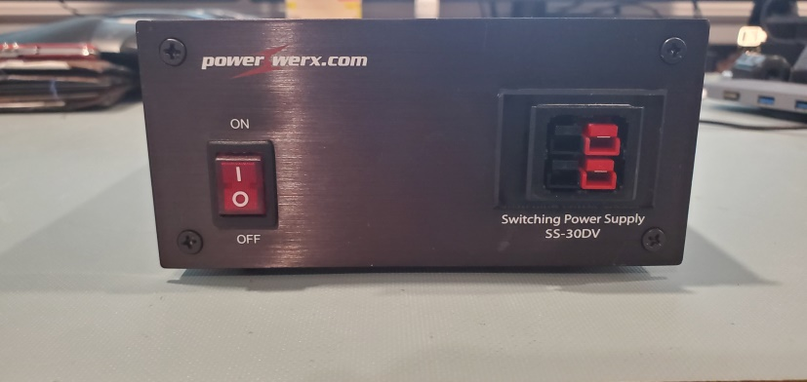
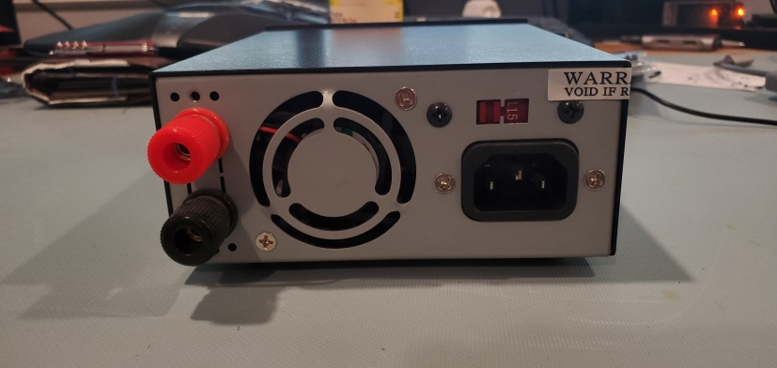
Example Power Supply
25 Amps 13.8 Volt DC output
6 Amp max 120 Volt Input
Anderson Power Pole connectors on front, which are preferred by most ARES based groups for easy connections.
Binding Posts on back
Switchable between US 120 Volts and International 240 Volt power.

Slide 28
Antenna
A ¼wavelength or longer antenna will be more efficient than a shortened antenna.
Some antennas can direct the radio waves in a particular direction, called gain, which can increase range to a particular station.
A better antenna does more for your range than a better radio.

Slide 29
Transceiver
TRANSmitter + reCEIVER a transmitter and receiver in one unit.
Push to talk button switches from receive mode to transmit mode.
Some models have multiple receivers built into the unit.
Depending on the unit, it will allow listening and transmitting on different ham bands (the most common is the 2 meter band). Many units support two or more bands of operations.
Different modulation types are available:
  FM (Frequency Modulation)
  AM (Amplitude Modulation)
  CW (Morse Code)
  SSB (Single Side Band, Lower Side Band or Upper Side Band)
  Digital Data (RTTY, JS8, FT8, Pactor, PSK32)
Typically all VHF radios will do FM, some will support multiple modes. Most HF radios are multi mode, providing SSB, CW, AM, and perhaps other modes.

Slide 30
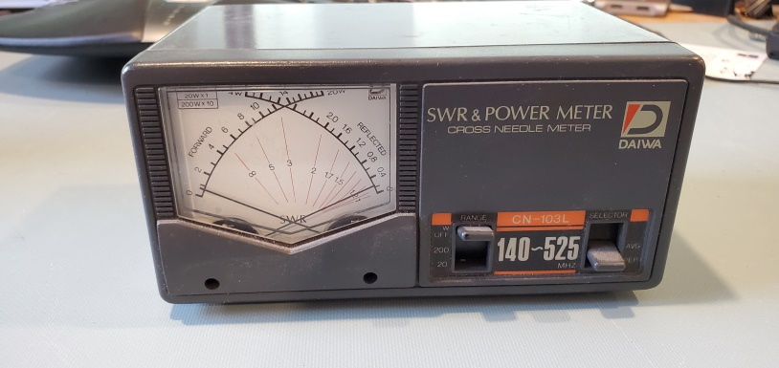
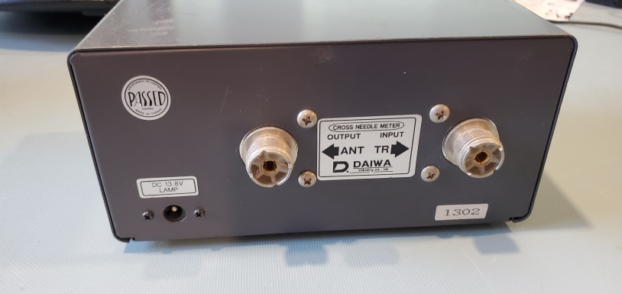
Station Accessories
SWR Meter
  Measures the amount of energy reflected by the antenna back to the transmitter if there is a impedance mismatch.
  Connected between the transmitter and the antenna:
  A lot of the fancier radios now have a SWR meter built in, particularly radios for use in the HF spectrum.
  I only use one for VHF & UHF if I suspect I have antenna issues or am setting up a new antenna. I recommend borrowing initially before buying one.
Front: forward and reflected power
Rear: SO239 Jacks toward Antenna and Transmitter, power is just to illuminate the meter face.

Slide 31
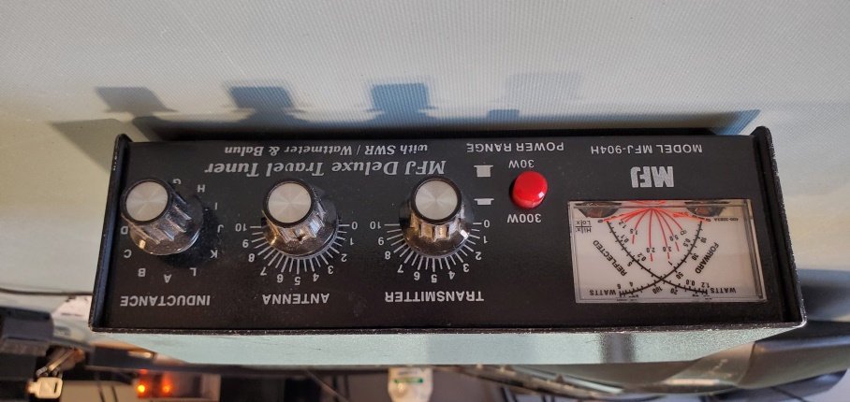
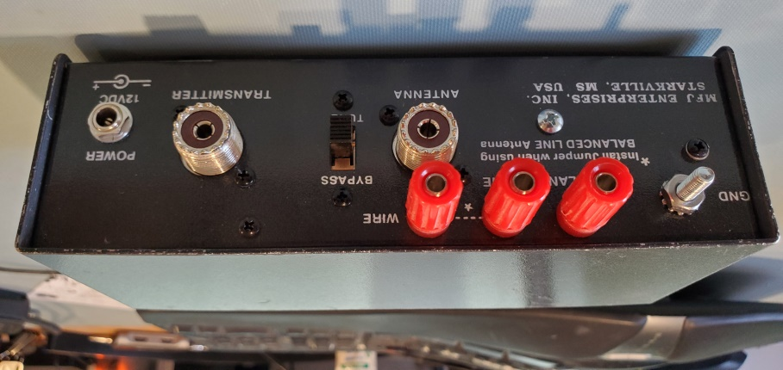
Antenna Tuner
Converts the impedance of the antenna and transmission line downstream from the tuner to match the 50 ohm impedance the transmitter wants.
Can be manual (like in this picture), or automatic (meaning it does all of the work to sense what the correct settings are when sensing you are transmitting.
Manual sensors include a SWR meter to aid in matching
This one requires no additional power (Power is to light the meter).
I use a remote automatic sensor on my home station.
Not common on spectrum above HF.

Slide 32
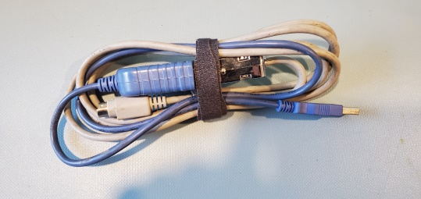
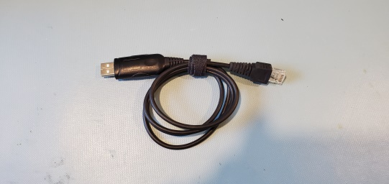
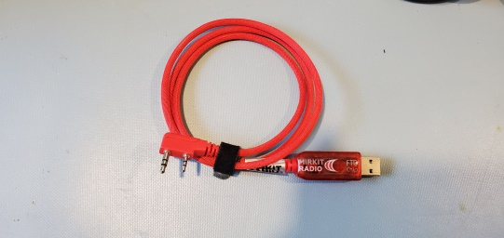
Programing / Control Cables
Allows computer to control radio:
  Makes it easy to setup memory channels
  On some radios allows triggering of Push To Talk function.
  Can be used to backup settings on the radio.
  Commercial radios modified for ham radio require these per FCC regulations (no end user modifications to frequencies are permitted).
Each manufacturer uses their own standard or clones the standard of a major brand.
USB most common these days, can also get RS232 versions.
Kenwood TM-V71A
Kenwood TM-V71A
Kenwood HT / Baofeng

Slide 33
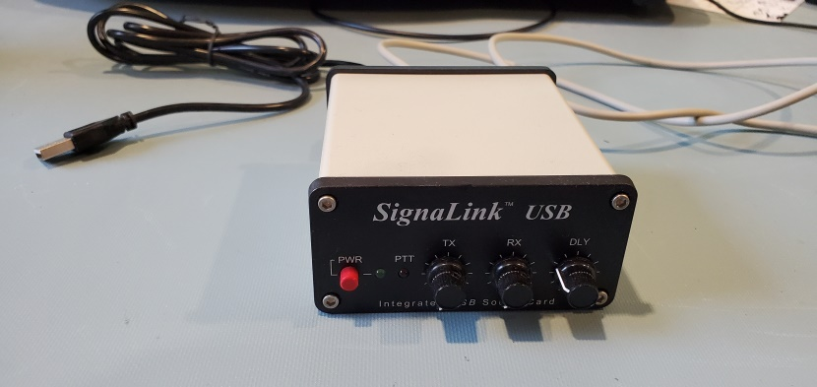
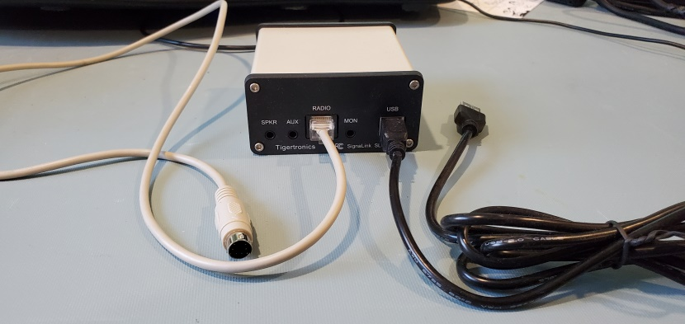
Sound Card Interface
Allows computer audio to be interfaced with two way radios.
White cable connects to radio speaker out and microphone in (in this case through a 6 pin accessory port on the radio)
This one has a USB sound card built in, so a single USB cable goes to the radio.
Allows the computer to press the radios Push To Talk (PTT) circuit.
Many radios now come with something like this built into the radio, requiring only a USB connection.
I made my own version of this when I first got into digital ham radio. Audio card speaker out to a attenuator and into the radio microphone port. Radio speaker out through a attenuator to the computer microphone in. I then used a serial port circuit to trigger the PTT on the radio.

Slide 34
Computers
Computers have become the ultimate station accessory.
Applications include:
  Logging Station Activity
  Computer sound card based digital radio communication.
  Easier control of the radio.
  Programing the radio for future ease of use
  Remote control of the station over the Internet.
  SDR (Software Defined Radio) processing and control.
  Many, Many other things.

Slide 35
Wires
All wires are slightly resistive.
The more current a wire carries the more it will resist (and heat up).
This resistance will cause the voltage to drop.
A thicker wire will resist less and lose less voltage over a long distance.
Therefore you want to have the shortest power cables you reasonably can, and use the thickest wires (heaviest gauge) you reasonably can to reduce voltage drop.

Slide 36
RF Conduction of wires
When electricity alternates, particulary from hundreds of cycles per second the electrical field only covers the surface of the conductor, this is called he skin effect.
This means the conductor with the most surface area will have the least resistant to RF currents.
So a flat strip will be more efficient than a round wire with the same amount of metal.
Flat straps are often used as part of RF ground and lightning protection systems.

Slide 37
Ferrite Chokes
Ferrite is a material that resists magnetic fields.
By wrapping a wire around a ferrite core or through a ferrite core you can absorb the RF that is traveling along the wire and prevent radio waves from leaking in through the cable to a device.
This is handy to prevent interference from radio waves coming into a radio through its shielded microphone cable.

Slide 38
Power in cars
A car’s power is said to be 12 volts, but it is really 14 – 15 volts DC.
The entire car chassis is used as the negative wire on most cars.
The battery holds voltage and acts as a temporary reservoir for power at times of heavy usage.
The Alternator generates the electricity the car uses / provides to accessories while the engine is running.

Slide 39
Hooking a radio into a car
Attach a fused positive line to the positive terminal of the battery. It must be a fuse protected wire.
Attach a fused negative wire at the negative post of the battery or the engine block ground strap.
Alternators can induce a high pitch whine on the transmitted signal that changes pitch with the engine speed.
A good quality battery can help smooth out / absorb alternator whine.

Slide 40
T4B – Operating Notes
Controls commonly found on radios and what they do.

Slide 41
Common Radio Controls
Most modern two-way radios have similar controls:
  Power Switch (I won’t dwell on this one)
  Volume Control (or this one)
  Push To Talk switch
  Tuning knobs and buttons
  Memory channels / controls
  Squelch
  A mode selector
  Automatic Gain Control
  Noise Blanker
  Receive bandwidth selection controls (filter width)
  Receiver Incremental Tuning (RIT)

Slide 42
Push To Talk (PTT)
Switches off the receiver side of the radio, moves the antenna from the receiver to the transmitter circuity, and activates the transmitter.
Many radios have multiple PTT switches (like a handheld radio with accessory speaker microphone).
Computers can be tied to the radio PTT via USB cables, RS232 cables + transistors, or in the case of hobby computer like the Raspberry Pi GPIO ports.

Slide 43
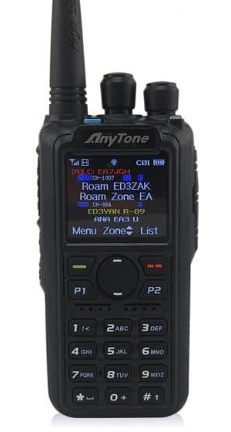
Tuning knobs and buttons
Tuning Knob
Selecting the correct operating frequency is called tuning the radio.
The receiver / transmit frequency is controlled by a variable frequency oscillator or VFO
Most radios have a knob you spin to move up (clockwise) or down (counter clockwise) in frequency. Many also have a keypad on the front that you can use to quickly enter the desired frequency.
Keypad

Slide 44
Memory Channels and Controls
With so many frequencies and ways of using Amateur radio it’s difficult to remember all of the settings you might need to use a particular repeater, or interact with a simplex based group.
Memory channels allow you to store all of the settings necessary to use a repeater or other interaction in a memory “channel” that can be selected easily.
Most radios now come with at least a hundred and twenty-eight channels. Many have over a thousand possible channels.

Slide 45
Scanning Memory Channels
Most Radios can continuously run through their channels until they find a signal.
This is called scanning.
How you get into the scanning mode depends on the radio…

Slide 46
Squelch
There are low levels of radio all around us. Some of it is naturally occurring, much is man made.
A squelch control allows you to make the radio ignore the noise. You adjust it until the static sound stops, then often just a little bit more to keep random noise from breaking through.
Now your radio will remain silent until there is something to listen to.
Squelch is not used for the Single Side Band, morse code, or other weak signal modes.

Slide 47
Mode selector
Multimode radios will have a mode selector button or switches.
This lets you switch between the modes typically:
  FM (Frequency Modulation)
  AM (Amplitude Modulation)
  SSB (Single Side Band)
  CW (Continuous Wave or Morse Code)

Slide 48
Automatic Gain Control
With AM modes (AM, SSB, & CW) the stronger the radio signal is the louder it will come out of the speaker.
This means if you are listening to a weak signal and a stronger signal comes on the air it can be too loud.
The AGC will automatically reduce the sensitivy of the radio if a loud signal appears and then slowly increase the sensitivity when that signal goes away.
This keeps the audio levels close to constant and much more pleasant to to listen to.

Slide 49
Noise Blanker
For AM modes the noise blanker reduces interference from rapid pulse or spark noise (like is made by a car’s spark plugs).
It detects a broad band pulse and momentarily reduces the sensitivity of the radio for the duration of the pulse, then restores the original sensitivity.
This is very effective on car ignition noise and lightning.
It differs from the AGC because it operates faster, and is looking for pulses with energy across a wide range of frequencies rather than the narrow portion that is being turned into sound by your receiver.

Slide 50
Bandwidth Controls (Filter Width)
Different modes have different signal widths or bandwidths:
  FM Narrow 12,500 Hz (FRS and business radios)
  FM 20,000 Hz (most common on amateur radio)
  AM 15,000 Hz
  SSB 2400 Hz (on the test)
  CW 100 – 500 Hz (on the test)
By filtering frequencies outside the signal width the noise and interference to the desired signal is reduced.
When looking for signals in CW or SSB I will often widen my filters to around 4kHz so I can hear more of the band at once. Once I have tuned in what I want to hear I will select the appropriate narrower filter.

Slide 51
Receiver Incremental Tuning (RIT)
Single Side Band has no carrier, so it’s hard to tell what the correct frequency is and being off frequency is more impactful (a receiver will lock onto the carrier of a FM or AM signal and compensate slightly for being off frequency).
Therefore, there is a fine tune control called a RIT or Clarifier that allows you to adjust what you are hearing up or down slightly while leaving your TX frequency fixed.
If you just adjust your VFO the other station will have to adjust there frequency as well and you will chase each other up and down the band. RIT allows you to fine tune what you hear, and they are responsible for adjusting what they hear.

